Slide 1


Green Pace
Security Policy Presentation
Developer: Noah Lane Garza

Slide 2

OVERVIEW: DEFENSE IN DEPTH
In today's digital age, security is paramount. This security policy has been crafted to provide a comprehensive framework that helps prevent potential vulnerabilities in both code development and system architecture. Our goal is to ensure that all developers at Green Pace adhere to best practices, thus supporting a defense-in-depth strategy.

Slide 3
THREATS MATRIX
The table categorizes security risks to provide a comprehensive overview of potential vulnerabilities, helping prioritize mitigation efforts.
Likely These are vulnerabilities that are frequently encountered and have significant consequences when exploited. Examples include SQL Injection and Cross-Site Scripting (XSS) | Priority Threats that are more likely to have a serious impact and are high level are set to priority.
Low priority Threats that are unlikely to have much impact and are low level are set to low priority | Unlikely These vulnerabilities are both infrequent and have a lower impact. Examples include Insufficient Logging and Monitoring and Cross-Site Request Forgery (CSRF).

Slide 4
10 PRINCIPLES
Input Validation
Authentication and Authorization
Default Deny
Error Handling and Logging
Data Protection
Communication Security
System Configuration
Database Security
File Management
Code Review and Testing

Slide 5
CODING STANDARDS
Consistency
Clarity and readability
Error handling and exceptions
Performance considerations
Security
Documentation
Naming conventions
Testing standards
Version control standards
Code review guidelines

Slide 6
ENCRYPTION POLICIES
Encryption in Flight: Data is encrypted during transmission over networks using protocols like TLS or SSL to prevent interception.
Encryption at Rest: Data stored on disk or in storage systems is encrypted to safeguard it from unauthorized access if physical devices are compromised.
Encryption in Use: Data is encrypted while being processed or accessed by applications to prevent exposure in memory or temporary storage.

Slide 7
TRIPLE-A POLICIES
Authentication - Verifies the identity of users or entities accessing the system.
Authorization - Determines the level of access and actions users are permitted to perform.
Accounting – Tracks and logs user activities for auditing, compliance, and security monitoring purposes.

Slide 8
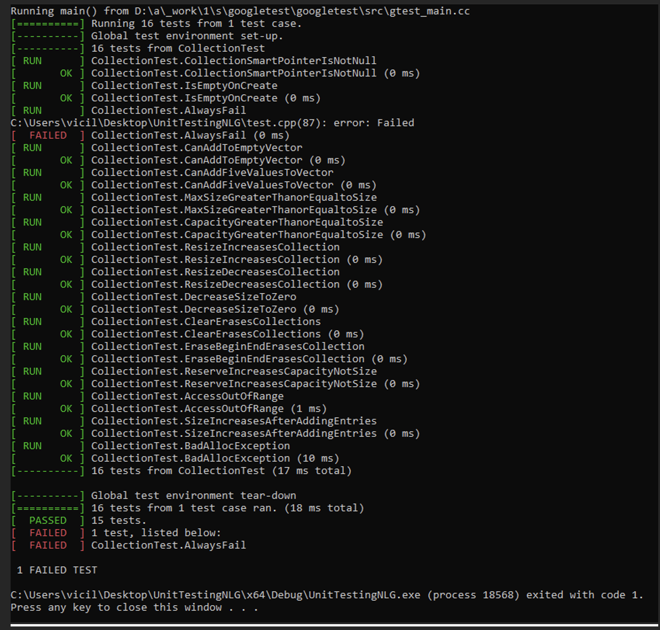
Unit Testing
In our software development process, we've implemented several unit tests to ensure the reliability and functionality of our code. Each test, such as testing specific functions or modules, aims to validate that individual units of code perform as expected.

Slide 9

AUTOMATION SUMMARY

Slide 10
TOOLS
The DevSecOps pipeline integrates security practices throughout the software development lifecycle to ensure continuous delivery of secure and reliable software.
SAST
DAST
RASP
GitLab
Aqualab

Slide 11
RISKS AND BENEFITS
Problems- Security Vulnerabilities, Compliance Risk, Customer Trust
Solution- Implement Secure Coding practices, Training and Awareness
Risks and Benefits – Immediate improvement in software security but the investment in tools and potential disruption of current development

Slide 12
RECOMMENDATIONS
GAPS
Lack of Emphasis on Application Security: Insufficient measures for secure coding and vulnerability assessments, exposing applications to risks like SQL injection and XSS.
(Real-World Example): The Equifax data breach in 2017 was caused by a vulnerability in Apache Struts, which was exploited through an unpatched system. This incident underscores the critical importance of robust secure coding practices and continuous vulnerability assessments to prevent similar breaches.
Weak Incident Response Plan: Inadequate procedures and training for incident response, potentially delaying mitigation efforts during security incidents.
(Real-World Example) During the WannaCry ransomware attack in 2017, organizations with weak incident response capabilities struggled to contain and mitigate the spread of the ransomware, resulting in widespread disruptions and financial losses. This highlights the necessity of a well-defined and practiced incident response plan to minimize the impact of such cyber incidents.
Limited Employee Cybersecurity Awareness: Insufficient training on cybersecurity best practices, increasing susceptibility to social engineering and inadvertent security breaches.

Slide 13
CONCLUSIONS
STANDARDS TO ADOPT
OWASP Standards- Adopting OWASP guidelines for secure coding practices and vulnerability assessments to proactively address and mitigate application security risks.
Regular Security Assessments - Conducting periodic security assessments and penetration testing to identify and rectify vulnerabilities before they can be exploited by malicious actors.

Slide 14
REFERENCES
Coding standards and guidelines. GeeksforGeeks. (2024, May 23). https://www.geeksforgeeks.org/coding-standards-and-guidelines/
ByteByteGo. (2024, February 3). EP97: 10 good coding principles to improve code quality. EP97: 10 Good Coding Principles to Improve Code Quality. https://blog.bytebytego.com/p/ep97-10-good-coding-principles-to

